Slide 1
Dashboard Introductory Hands-On Exercise – Part 2
Data Visualization
John F. Tripp

Slide 2
Dashboard Optimization
Replacing the top and bottom 5 graphs with a single graph
Better utilizing all the pixels.

Slide 3
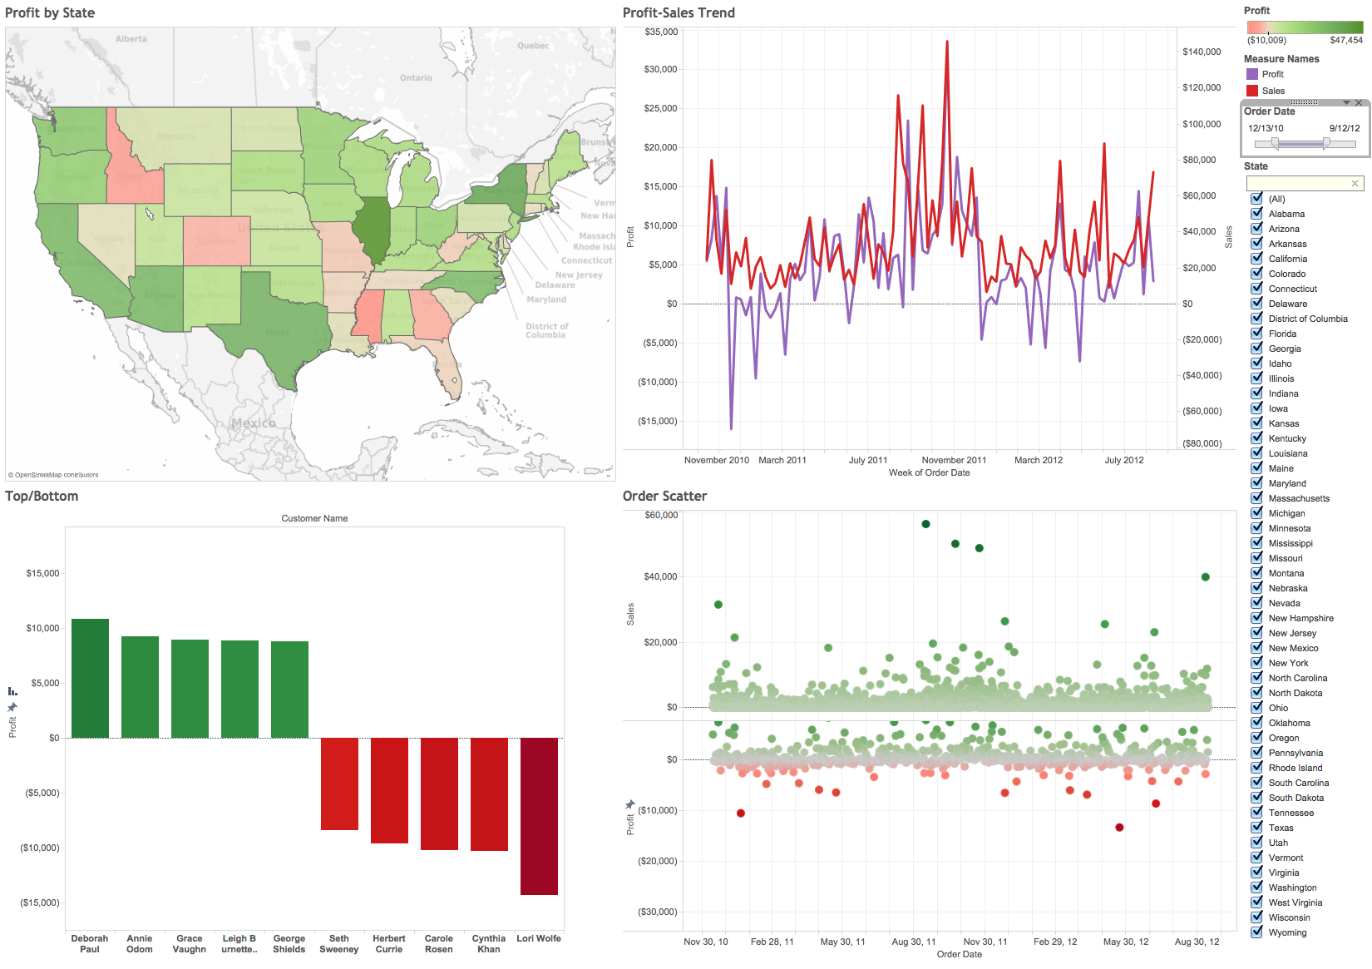

Slide 4
Two “Optimal” Visualizations
Two newer visualizations that are optimal for dashboards
  Sparklines
    Popularized by Tufte
    http://www.edwardtufte.com/bboard/q-and-a-fetch-msg?msg_id=0001OR&topic_id=1
  Bullet Graphs
    Decorated bar chart
    Developed by Stephen Few
    http://www.freakalytics.com/wp-content/uploads/Bullet_Graph_Design_Spec.pdf

Slide 5
Bullet Graphs
“Decorated” bar chart
  Vertical line indicating “goal” or “comparison” value.
  60%, 80%, 100% distribution shading of goal value.

Slide 6
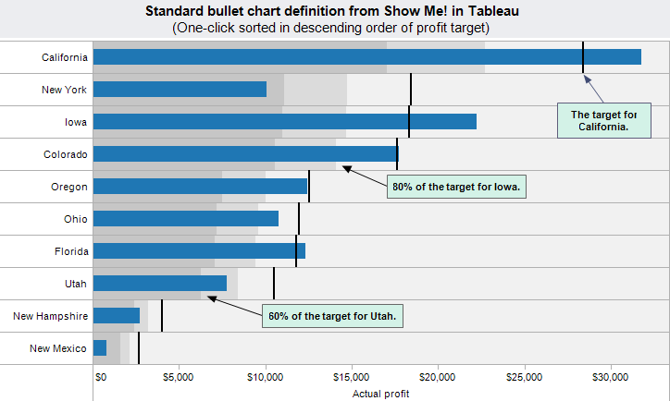
80% of the target for Colorado

Slide 7
Sparklines
Present the general shape of variation over time.
Typically have no axes or gridlines

Slide 8
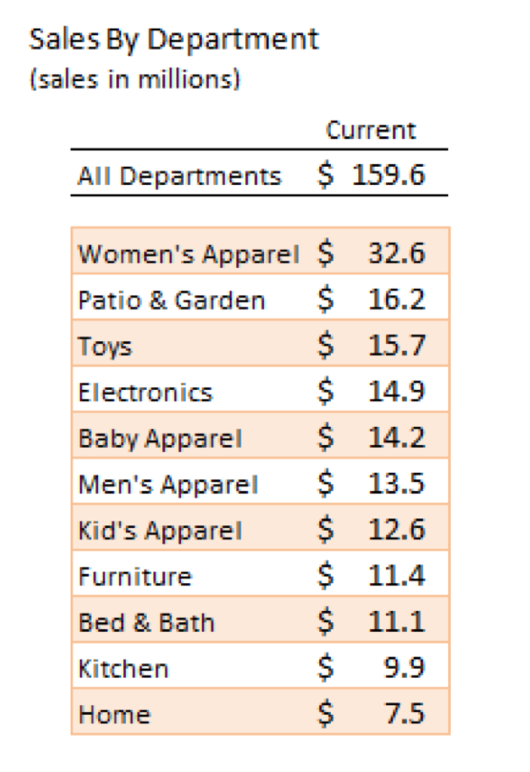

Slide 9
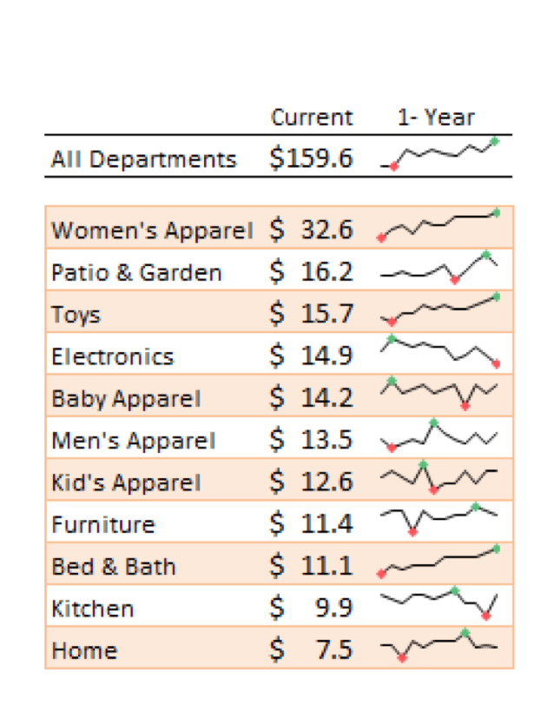

Slide 10
Sparklines and Bullet Graphs
Are extremely information dense.
Replace large graphical components on dashboards
Allow for more insight at a glance.

